Slide 1
caArray User Community Meeting
2.0.1 and 2.1.0 releases
Call in: 877-416-5524
Participant Passcode: 2627056
Centra: http://ncicb.centra.com
Meeting ID: array_april2
April 2, 2008

Slide 2
Agenda
Overview of 2.0.1 release
  Scope review
Planning for 2.1.0 release
  Scope and schedule
Questions for consideration
General Q&A and user feedback

Slide 3
caArray 2.0.1 Release
Schedule
  caArray 2.0.1 will be released tomorrow, 4/3/08
Scope
  Primarily addresses known issues in 2.0.0. Detailed scope in release notes
  Over 70 GForge items included
Installation
  NCICB instance will be upgraded overnight tonight (https://array.nci.nih.gov)
  For groups with caArray 2.0.0 installations, an upgrade installer will be provided
  For groups new to caArray2, a full 2.0.1 distribution package will be provided

Slide 4
caArray 2.0.1 – Key items addressed
[#12107] Valid Illumina SNP design files fail validation
  Fixes bug that blocked upload of Illumina SNP designs
[#12408] Importing data files of the same name leads to duplicate object names in the experiment chain
[#12732] Ability to Download All Files from Experiments of Substantial Size
  Large downloads are broken into smaller chunks
[#12344] Allow file Upload to occur as a background process
  New window opens to support the upload process
[#11790] Importing IDF, SDRF, and data files without defining Array Design in Experiment Overview
  Can now Import (not parse) these additional array design types:
    Agilent CSV, Agilent XML, ImaGene TPL, Nimblegen NDF, UCSF Spot SPT
[# 12117] Authenticated access via API does not allow access to authorized, non-public objects

Slide 5
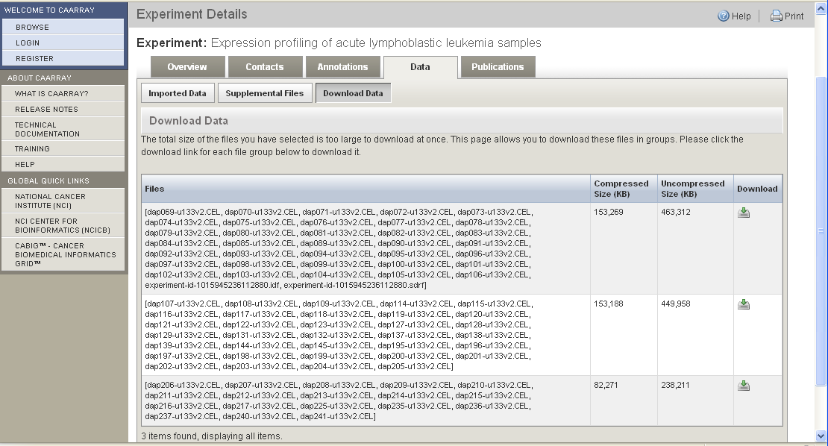
[#12732] Ability to Download All Files from Experiments of Substantial Size

Slide 6
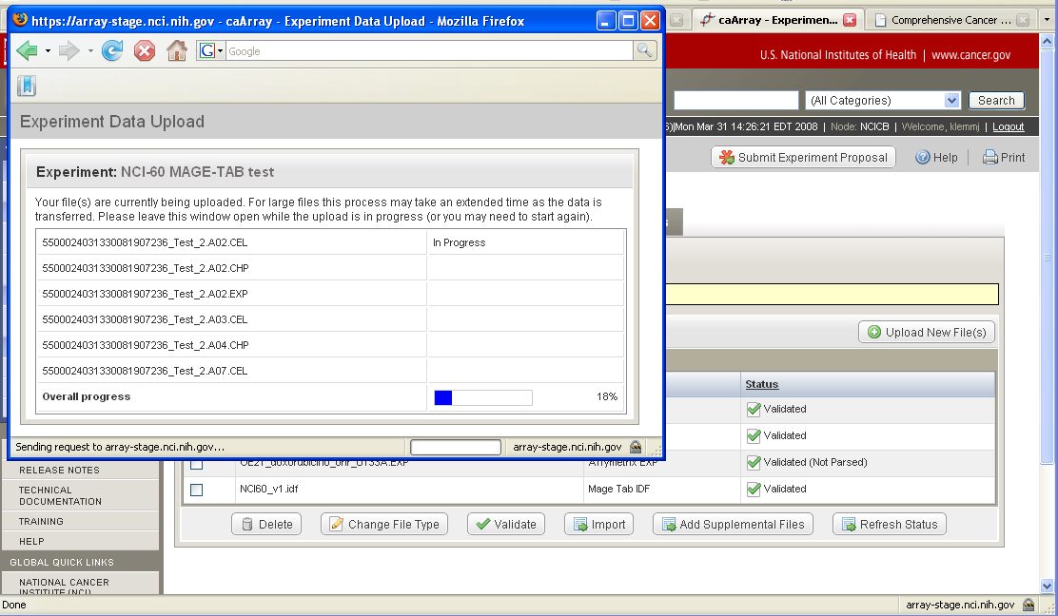
[#12344] Allow file Upload to occur as a background process

Slide 7
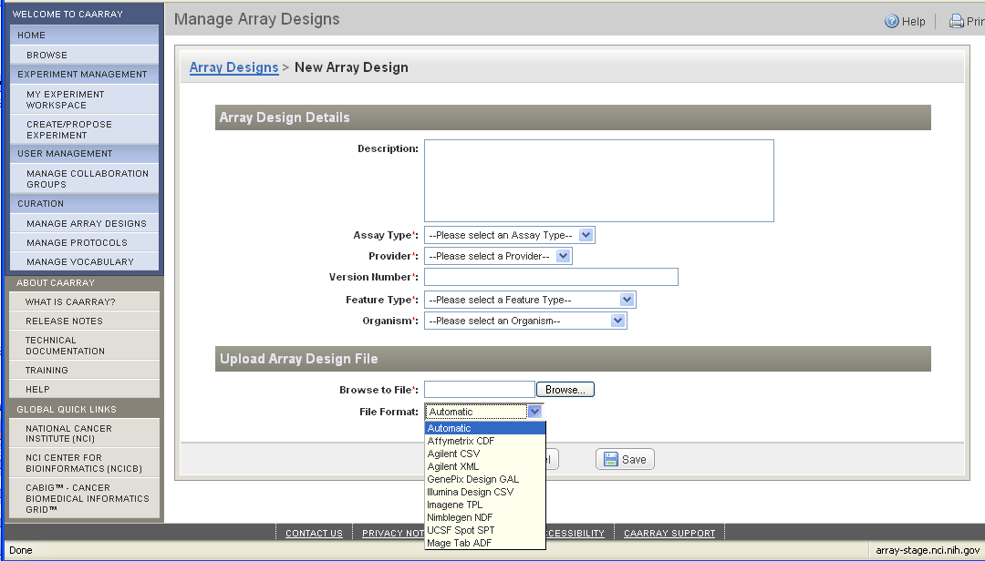
[#11790] Can now Import (not parse) additional array design types

Slide 8
caArray 2.1.0
Schedule: Planning for a June, 2008 release
Scope: Planning in progress but will include open defects plus additional functionality
Query Defect Tracker and Feature Request Tracker for target_release=2.1.0 for visibility into current planning
  Defects:
  http://gforge.nci.nih.gov/tracker/?atid=1344&group_id=305&func=browse
  Feature requests:
  http://gforge.nci.nih.gov/tracker/?atid=1273&group_id=305&func=browse
May consider an interim release, if necessary

Slide 9
caArray 2.1.0 - Planning
Items under consideration include
  Implementation of GridTransfer, made available in caGrid 1.2
  Implementation of Grid Security
  Ability to query other caArray Grid instances
  Additional API enhancements
  [#11925] Support PGF and CLF files for Affymetrix array design import (necessary for Exon arrays)
  [#12252] Provide a mechanism to allow array data files to be associated with pre-populated annotations (demo last month)
  Allow viewing and application of multiple protocols through the UI
  [#10115] Ability to delete Experiments

Slide 10
Specific questions for feedback
Vocabularies
  Limit Material Type and Protocol Type vocabularies to the MGED Ontology terms that are pre-loaded in caArray?
  Remove Source Version from the terminology source?
  For incoming MAGE-TAB documents, if a term with a source comes in where there is a matching term from a different source already in the database, ask the user whether they want to reuse one of the matches or create the term used in the MAGE-TAB. Default behavior would be to reuse existing terms.

Slide 11
Specific questions for feedback
Assay type selection
  Current vocabulary
    Gene Expression
    SNP
    Exon
    aCGH
    microRNA
    Methylation
  Proposed vocabulary (from City of Hope). Remove current limitation of 1 assay type per design.
    3’ expression
    whole-transcript expression
    ChIP-chip
    Transcript Mapping
    SNP
    Resequencing
    DNA Methylation
    aCGH
    microRNA

Slide 12
Additional areas where we need feedback
Biomaterial pages
Priorities for platforms to support for parsing
Barriers to adoption
Feature priorities that have been captured but not implemented (search on target release=Deferred in the Feature tracker: https://gforge.nci.nih.gov/tracker/?atid=1341&group_id=305&func=browse)

Slide 13
Mechanisms for feedback
caArray Users listserv
  We welcome and encourage active exchanges on this listserv to share experiences with the product
Community Change Request tracker
  http://gforge.nci.nih.gov/tracker/?atid=1339&group_id=305&func=browse
This meeting
  With the product in your hands now, we will devote a significant portion of this monthly meeting to answering your questions and soliciting your feedback
  As we scope each release, we will review the priorities with the participants on this call

Slide 14
Next meeting date:
Wednesday, May 7, 2pm ET

